Slide 1

Exploratory Data Analysis
<G2M insight for Cab Investment firm>
<21 November 2024>
Done by: Ethan Dy during LISUM39

Slide 2

Agenda
Executive Summary
Problem Statement
Approach
EDA
EDA Summary
Recommendations

Slide 3
Executive Summary
Investment Analysis of the US Cab Industry for XYZ
Objective: Evaluate two cab companies to determine the best investment opportunity for XYZ.
Key Findings:
Yellow Cab demonstrates stronger performance across ride volume, profitability, and customer loyalty.
Middle-aged customers (30-50 years) drive the highest ride frequency.
City-level demand varies and does not align strictly with population density.

Slide 4
Problem Statement
Industry Context:
The US cab industry has seen remarkable growth in recent years with increasing competition among key players.
XYZ, a private firm, aims to enter the market and needs data-driven insights to decide between two cab companies for investment.
Data Overview:
Cab_Data.csv: Transaction details for two companies from 2016 to 2018.
Customer_ID.csv: Customer demographics and unique identifiers.
Transaction_ID.csv: Links transactions to customers and payment modes.
City.csv: City population, cab usage, and other geographical details.
Challenges:
Split and diverse datasets require management and cleaning.
Understanding the profitability trends, customer wants/needs, and demographics.
Identifying the extreme insights for a strategic investment decision.

Slide 5
Approach
Content:
Data Preparation: Cleaned, transformed, and merged datasets (Cab_Data, Customer_ID, Transaction_ID, City.csv).
Exploratory Data Analysis (EDA): Investigated trends in profitability, customer demographics, and city-level usage.
Hypothesis Testing: Validated assumptions about ride volume, city size, and customer loyalty.
Comparison: Evaluated Yellow Cab vs. Pink Cab on key performance metrics.

Slide 6
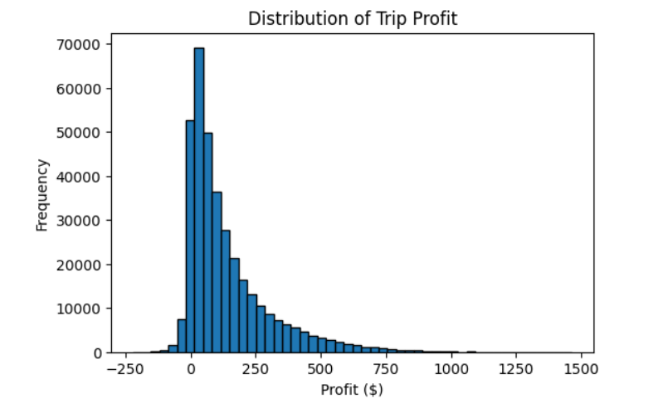
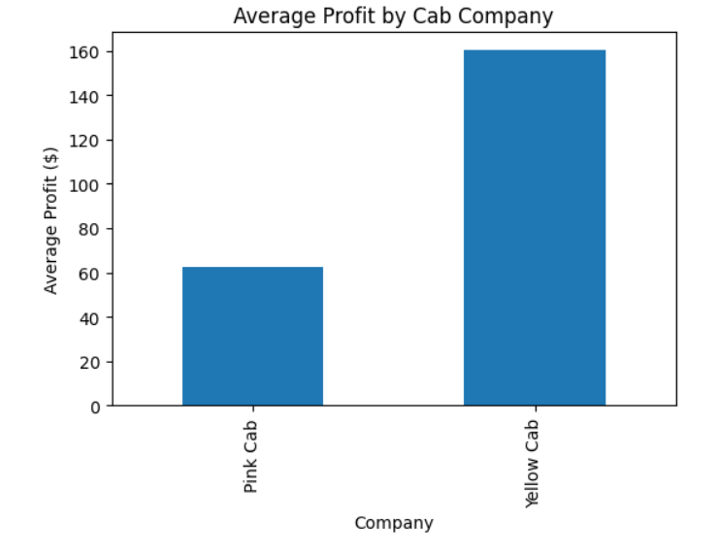
Exploratory Data Analysis (EDA)
Distribution of Trip Profit
Average Profit by Cab Company
- Most trips skews towards lower profit margins
- Majority of profit is below $250
- Yellow cab shows higher profits
- Profit gap favors yellow cab

Slide 7
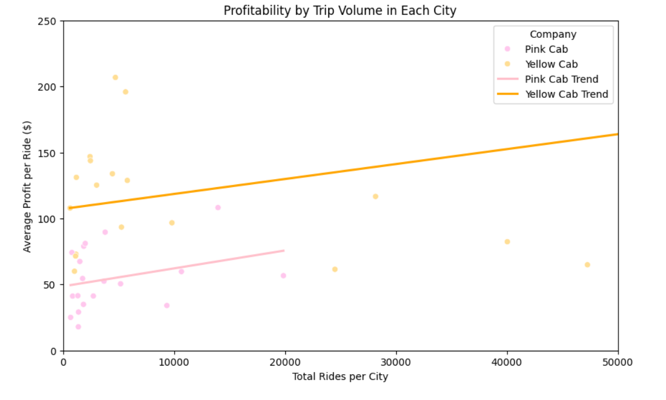
Exploratory Data Analysis (EDA)
Cities Profitability by Trip Volume
• Null Hypothesis (H0): There is no relationship between the number of rides in a city and the average profit per ride for either company.
• Alternative Hypothesis (H1): Cities with a higher number of rides have a lower average profit per ride for both companies.

Slide 8
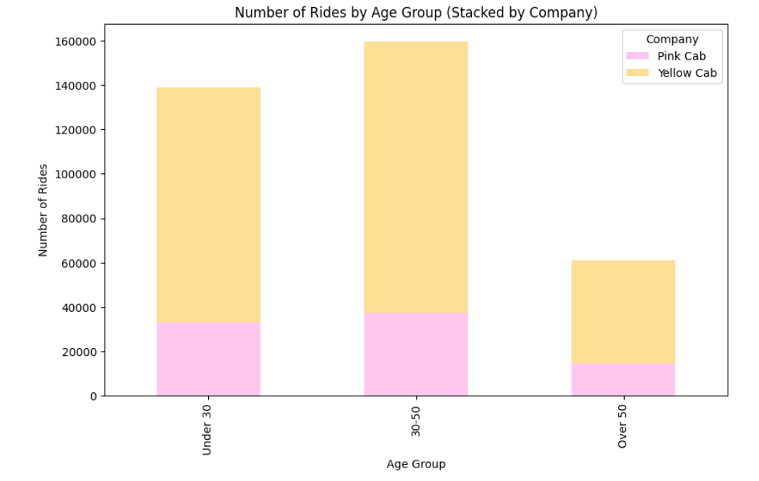
Exploratory Data Analysis (EDA)
Customer Age Impact on # of Rides
• Null Hypothesis (H0): There is no difference in the average number of rides taken by older customers compared to younger customers, regardless of the cab company.
• Alternative Hypothesis (H1): Older customers take more rides on average than younger customers, regardless of the cab company.

Slide 9
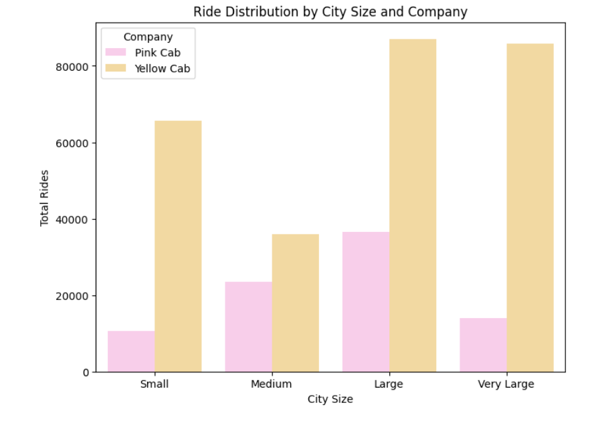
Exploratory Data Analysis (EDA)
Ride Distribution from City Size
• Null Hypothesis (H0): There is no difference in the presence of Pink Cab and Yellow Cab across cities of different sizes.
• Alternative Hypothesis (H1): Pink Cab has a stronger presence in smaller cities, while Yellow Cab is more dominant in larger cities.

Slide 10
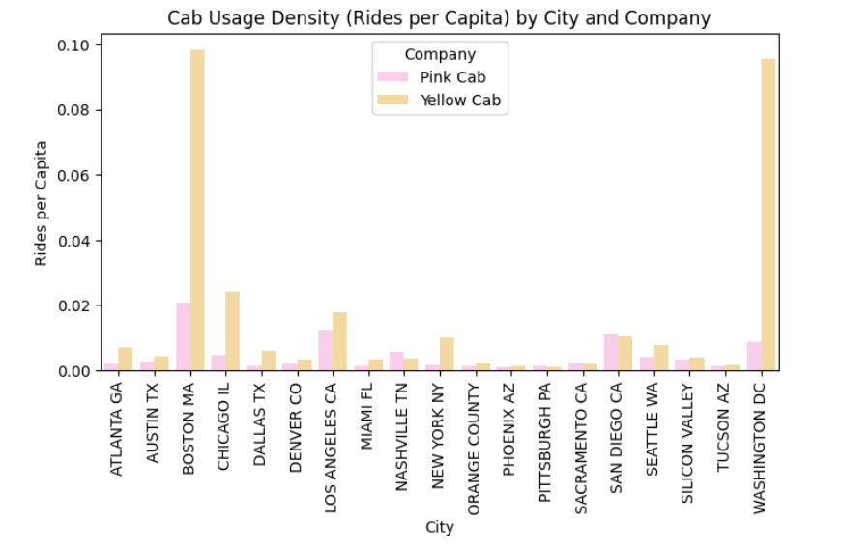
Exploratory Data Analysis (EDA)
City Pop. Density vs Cab Usage
• Null Hypothesis (H0): Cab usage density (rides per capita) does not vary with city population size for either company.
• Alternative Hypothesis (H1): Cab usage density is higher in more densely populated cities, indicating a stronger customer base in these
areas for both companies.

Slide 11
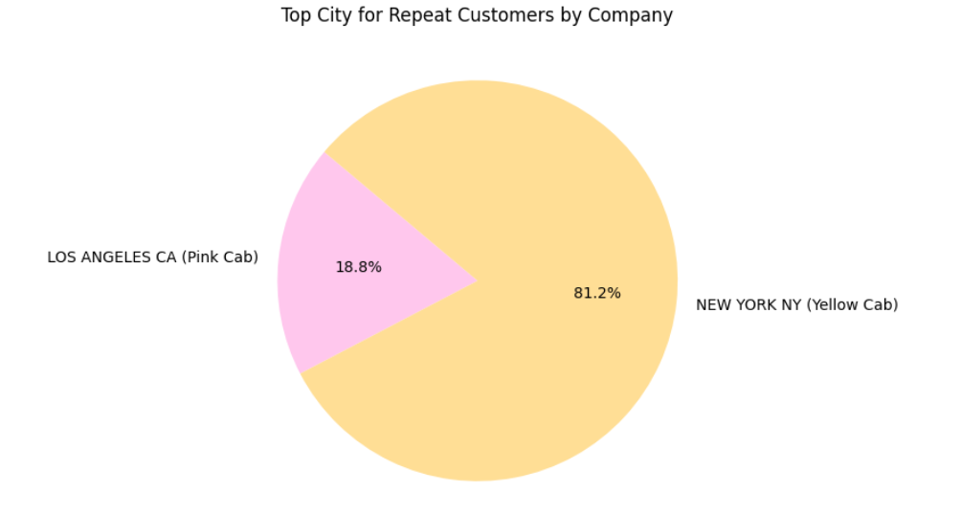
Exploratory Data Analysis (EDA)
Top City for Repeat Customers
• Null Hypothesis (H0): There is no difference in the concentration of repeat customers between Yellow Cab and Pink Cab in any specific
city.
• Alternative Hypothesis (H1): Yellow Cab has a higher concentration of repeat customers in certain cities compared to Pink Cab.

Slide 12
EDA Summary
Hypothesis Results
Profitability by Trip Volume:
Result: Not supported. The data did not show an inverse relationship between ride volume and profit per ride; in fact, both companies showed stable or slightly increased profitability with higher ride counts.
Customer Age Impact on Ride Frequency:
Result: Not supported. Middle-aged customers (age 30-50) took the most rides, while the "Over 50" group took the fewest, contradicting the initial hypothesis.
Ride Distribution Based on City Size:
Result: Not supported. Yellow Cab was dominant across all city sizes, with no indication that Pink Cab had a stronger presence in smaller cities.
City Population Density vs. Cab Usage:
Result: Partially supported. Some densely populated cities showed high usage density, but this was inconsistent across all cities, suggesting other factors beyond population size influence cab demand.
Top City for Repeat Customers by Company:
Result: Supported. The data showed a significantly higher concentration of repeat customers for Yellow Cab in New York City compared to Pink Cab’s top city (Los Angeles).

Slide 13
Recommendations
After analyzing the data and testing my hypotheses, here are some of my recommendations:
Target Middle-Aged Customers to Boost Ride Numbers
- Finding: Customers aged 30-50 are taking the most rides, while those over 50 are taking the least
Explore Different Opportunities in High-Demand Cities
- Finding: Certain cities like Boston, MA and Washington, DC have higher cab usage density, but this doesn't always match up with population size
Differentiate Services to Stand Out
- Finding: Yellow Cab dominates in ride numbers across all city sizes, and Pink Cab doesn't have a stronger presence in smaller cities as initially thought
Increase Customer Loyalty and Repeat Business
- Finding: Yellow Cab has more repeat customers, especially in cities like New York

Slide 14
Thank You

